Slide 1
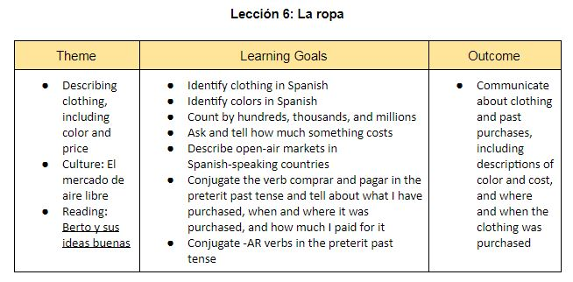
Unit 6 Goal Setting

Slide 2
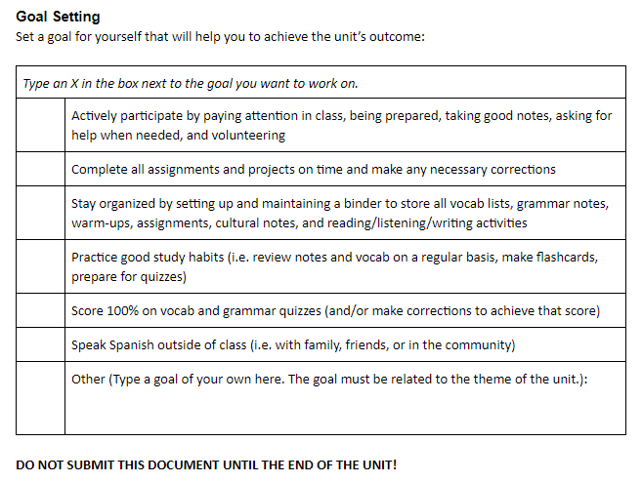

Slide 3
Vocabulario 6A
Lección 6: La ropa

Slide 4
Yo puedo…
I can…
Identify clothing in Spanish
Success Criteria
Label an article of clothing based on a visual representation
Describe what someone is wearing

Slide 5
La ropa
The clothes (clothing)

Slide 6
La blusa
The blouse
A top for women, does not necessarily have to have buttons or a collar

Slide 7
Las botas
The boots

Slide 8
Los calcetines
The socks
The singular form is “calcetín”

Slide 9
La camisa
The shirt
Traditionally refers to a button-down shirt
Can be long or short sleeve

Slide 10
La camiseta
The T-shirt

Slide 11
La chaqueta
The jacket

Slide 12
La falda
The skirt

Slide 13
Los jeans (bluejeans)
The jeans

Slide 14
Los pantalones
The pants

Slide 15
Los pantalones cortos
The shorts

Slide 16
Las sandalias
The sandals

Slide 17
La sudadera
The sweatshirt
La sudadera con capucha = hooded sweatshirt

Slide 18
El suéter
The sweater

Slide 19
Los tacones
The high heels

Slide 20
El traje
The suit
El traje de baño = bathing suit

Slide 21
El vestido
The dress

Slide 22
Los zapatos
The shoes

Slide 23
Los zapatos de tenis
The tennis shoes; sneakers
Sometimes simply referred to as “los tenis”

Slide 24
llevar
To wear
Yo llevo
Tú llevas
Él/ella/usted lleva
Nosotros llevamos
Vosotros lleváis
Ellos/ellas/ustedes llevan
This verb can also mean “to carry”

Slide 25
¿QuiéN lleva…?
Practicar
Stand up if the clothing item mentioned applies to you today.

Slide 26
Vocabulario 6B
Lección 6: La ropa

Slide 27
Yo puedo…
I can…
Identify colors in Spanish
Success Criteria
Ask and tell my favorite color
Ask and describe the color(s) of various things, including clothing
Make colors (adjectives) agree in gender and number with the noun that they are describing

Slide 28
Amarillo/a
Yellow

Slide 29
Anaranjado/a
Orange
This is the color, not the fruit (la naranja)

Slide 30
Azul
Blue
Gender neutral
To make plural, add -es

Slide 31
Blanco/a
White

Slide 32
Marrón
Brown
Gender neutral
To make plural, add –es
When this adjective is made plural, it loses the accent mark over the -o

Slide 33
Morado/a
Purple

Slide 34
Negro/a
Black

Slide 35
Rojo/a
Red

Slide 36
Rosado/a
Pink

Slide 37
Verde
Green
Gender neutral

Slide 38
gris
Gray
Gender neutral
To make plural, add -es

Slide 39
Hablar de Los colores
¿Cuál es tu color favorito?
Mi color favorito es ____________ (use the masculine form)
¿De qué color?
What is your favorite color?
My favorite color is _______.
What color? (asking for a description)

Slide 40
¿De qué color?
Practicar

Slide 41
Hablar: ¿De qué color?
Object: Ask and describe the color of clothing.
Procedure:
Everyone takes a card from the basket on their table
These cards are new- do not bend, peel, or otherwise destroy them
Meet with your classmates to ask the question at the top of your card
Answer your classmates’ question by completing the sentence at the bottom of the card with the correct color
Practice saying the whole sentence
Watch gender and number of adjectives (it must match the noun you are describing)
If your classmate gets the answer wrong, explain the correct answer by using the key on the back of the card
Trade cards and repeat the process as many times as possible within the time provided
Return to seats when told to and put the cards in the basket

Slide 42
Yo veo algo…
I spy…

