Slide 1
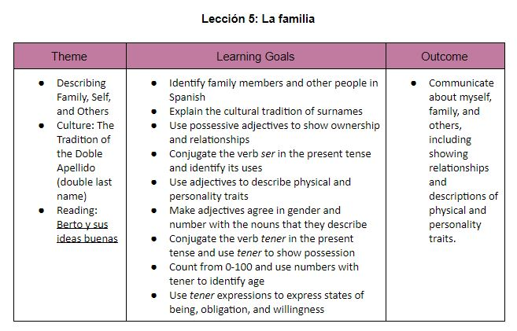
Lección 5: La familia

Slide 2
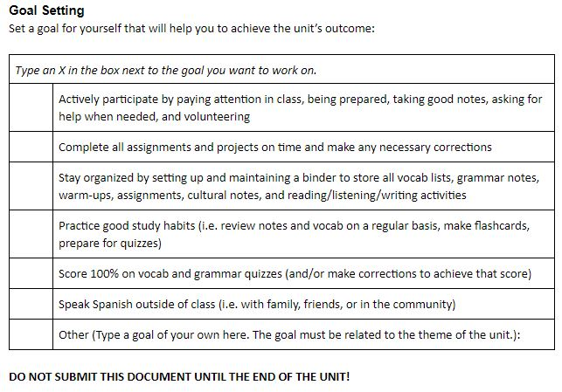
Unit 5 Goal Setting

Slide 3
Vocabulario 5A
Lección 5: La familia

Slide 4
Yo puedo…
I can…
Identify family members in Spanish
Success Criteria
Use the Spanish sound system to accurately pronounce family vocabulary
Use family vocabulary to label a family tree

Slide 5
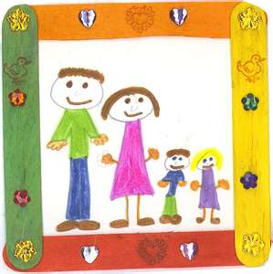
La familia
The family

Slide 6
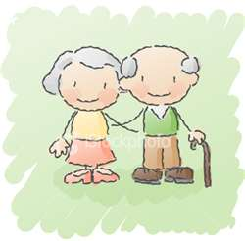
Los abuelos
The grandparents
El abuelo
La abuela
El bisabuelo
La bisabuela
The grandfather
The grandmother
The great-grandfather
The great-grandmother

Slide 7
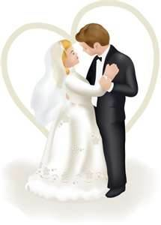
Los padres
The parents
El padre
La madre
El padrastro
La madrastra
El esposo
La esposa
The father
The mother
The stepfather
The stepmother
The husband
The wife

Slide 8
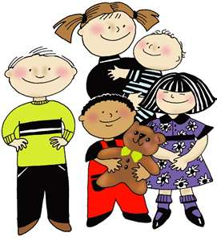
Los hijos
The children
El hijo
La hija
El hijastro
La hijastra
El nieto
La nieta
The son
The daughter
The stepson
The stepdaughter
The grandson
The granddaughter

Slide 9
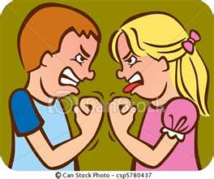
Los hermanos
The siblings
El hermano
La hermana
El hermanastro
La hermanastra
El medio hermano
La media hermana
El gemelo
La gemela
The brother
The sister
The stepbrother
The stepsister
The half-brother
The half-sister
The twin brother
The twin sister

Slide 10
Los tíos
El tío
La tía
El primo
La prima
The uncle
The aunt
The male cousin
The female cousin
Los primos
The cousins

Slide 11
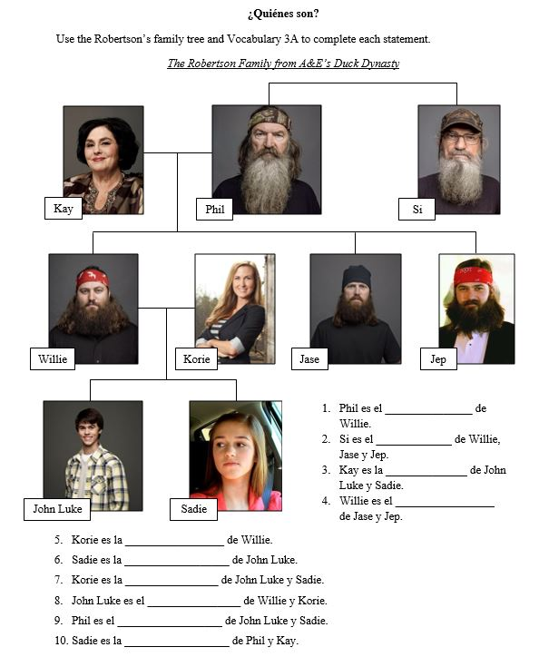

Slide 12
Vocabulario 5A
Lección 3: La familia

Slide 13
Yo puedo…
I can…
Identify family members in Spanish
Success Criteria
Use the Spanish sound system to accurately pronounce family vocabulary
Use family vocabulary to label a family tree

Slide 14
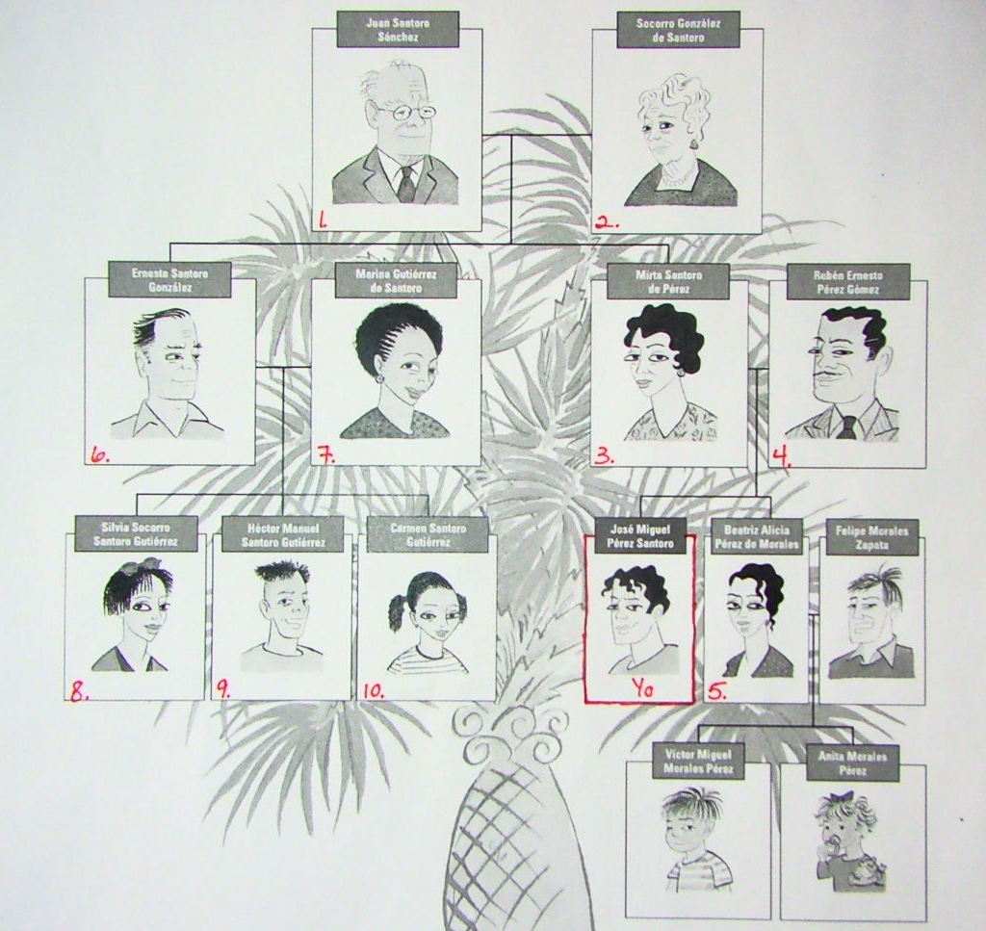

Slide 16
Familia Bingo
Object: Get five in a row (horizontal, vertical, or diagonal) by recognizing the meaning of terms from Vocab 3A
Materials: Bingo cards, dry-erase markers, eraser washcloths, and envelope with 30 vocab cards (no notes!)
Do not bend, peel, or otherwise destroy the game pieces or waste the markers/leave them uncapped
How to Play:
Choose one person who will be the bingo caller
This person does not play on a bingo card
The caller will pull a card from the envelop and read the bolded term in Spanish using best pronunciation
Set aside the used cards to be able to check players’ bingo cards
Do not show the card because the English answer is on it
Each player will check for the English equivalent on their bingo card
Not all terms appear on each card
Mark the corner of the square with a dry-erase marker
Do NOT color in the entire square as you will need to be able to prove your answers
When a player has a bingo, he or she will call out “¡Familia!”
The player will then read their terms in SPANISH while the caller checks the answers
Winners can see me for a candy ☺. Winners become the caller for the next round.
Notes:
Winners check with Caller first, if approved spot check two random terms for candy

Slide 17
Familia Bingo
El abuelo
La abuela
El bisabuelo
La bisabuela
Los padres
El padre
La madre
El padrastro
La madrastra
El esposo
La esposa
El hijo
La hija
El hijastro
El hermano
La hermana
La hermanastra
El medio hermano
El gemelo
El nieto
El tío
La tía
El primo
La prima

Slide 18
Vocabulario 5B
Lección 5: La familia

Slide 19
Yo puedo…
I can…
Identify relatives (family) and other people in Spanish
Success Criteria
Use the Spanish sound system to accurately pronounce family vocabulary
Use family vocabulary to label a family tree

Slide 20
Los parientes
Los parientes
El sobrino
La sobrina
El suegro
La suegra
El yerno
La nuera
El cuñado
La cuñada
The relatives
The nephew
The niece
The father-in-law
The mother-in-law
The son-in-law
The daughter-in-law
The brother-in-law
The sister-in-law

Slide 21
Otras personas
El amigo
La amiga
La gente
El hombre
La mujer
El muchacho
La muchacha
The (male) friend
The (female) friend
The people
The man
The woman
The boy
The girl

Slide 22
Otras personas
El niño
La niña
El novio
La novia
La persona
El perro
El gato
The (male) child
The (female) child
The boyfriend
The girlfriend
The person
The dog
The cat

Slide 24
