Slide 1
Vocabulario 4A
Lección 4: La comida

Slide 2
Yo puedo…
I can…
Identify foods and meals (breakfast, lunch, dinner) in Spanish
Describe my likes/dislikes regarding food
Success Criteria
Be able to label a food item in Spanish when given a visual representation
Tell what I do/don’t like to eat for breakfast, lunch, and dinner

Slide 3
La comida
¿Qué te gusta comer en…?
el desayuno
el almuerzo
la cena
Me gusta comer…
What do you like to eat in (for)…?
The breakfast
The lunch
The dinner
I like to eat…

Slide 4
La comida del desayuno

Slide 5
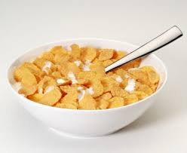
El cereal
The cereal

Slide 6
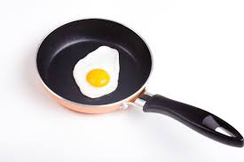
El huevo
The egg
Change “el” to “los” and add –s to make it plural

Slide 7
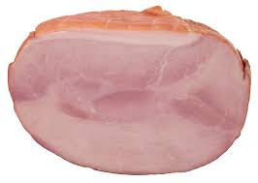
El jamón
The ham
Ham is a popular meat in Spain

Slide 8
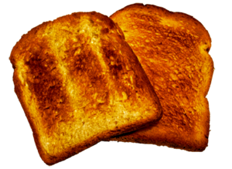
El pan tostada
The toasted bread

Slide 9
La comida del almuerzo

Slide 10
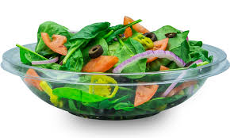
La ensalada
The salad

Slide 11
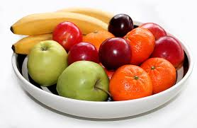
Las frutas
The fruit

Slide 12
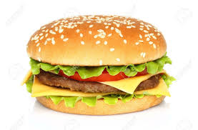
La hamburguesa
The hamburger

Slide 13
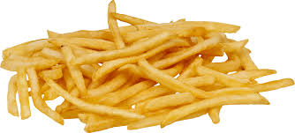
Las papas fritas
The French fries

Slide 14
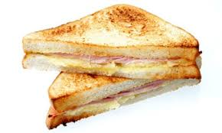
El sándwich (de jamón y queso)
The sandwich
Of ham and cheese (ham and cheese sandwich)

Slide 15
La comida de la cena

Slide 16
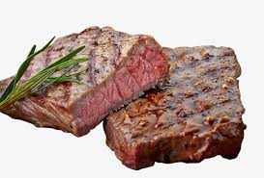
El bistec
The steak

Slide 17
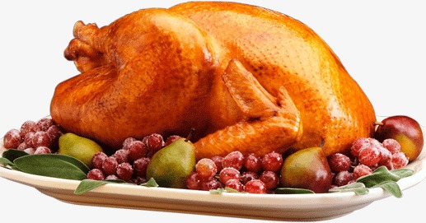
El pollo
The chicken

Slide 18
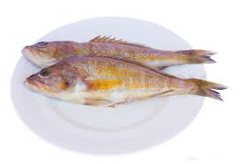
El pescado
The fish

Slide 19
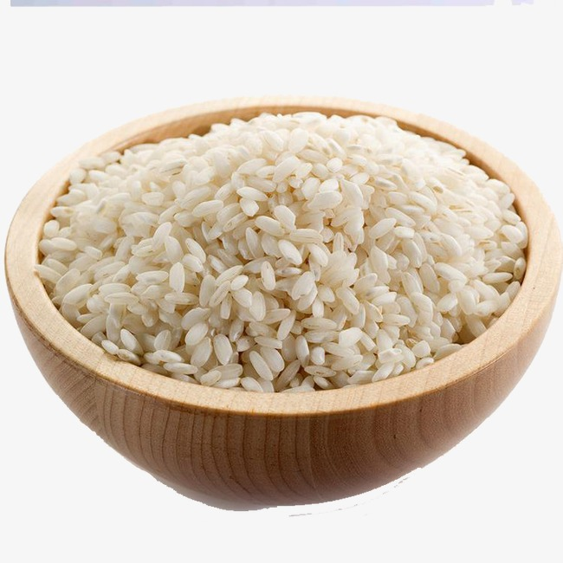
El arroz
The rice

Slide 20
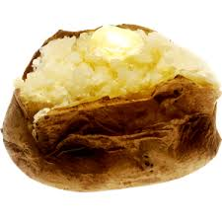
Las papas al horno
The baked potatoes

Slide 21
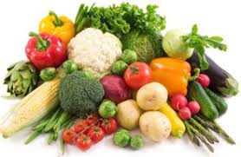
Las verduras
The vegetables

Slide 22
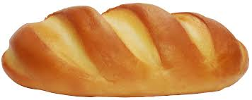
El pan
The bread

Slide 23
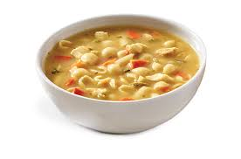
La sopa (de pollo; de verduras)
The soup
Of chicken (chicken soup)
Of vegetables (vegetable soup)

Slide 24
Matamoscas
Object of the Game:
You will hear a term in Spanish. Race an opponent to be the first to hit the corresponding picture with your flyswatter.
Rules:
You must stand behind the line
No false starts
Do NOT block or hit your opponent
Do NOT hit the projector
Teammates need to be quiet or lose points!

Slide 28
Vocabulario 4B
Lección 4: La comida

Slide 29
Yo puedo…
I can…
Identify fruits, vegetables, and desserts in Spanish
Tell if I am hungry
Success Criteria
Label pictures of fruits, vegetables, and deserts in Spanish
Complete sentences with missing food items based on a picture provided and context clues

Slide 30
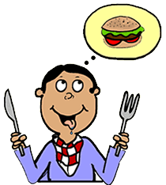
Tengo hambre
I am hungry
Literally “I have hunger”

Slide 31
Las frutas
The fruit

Slide 32
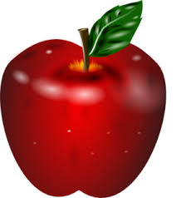
La manzana
The apple

Slide 33
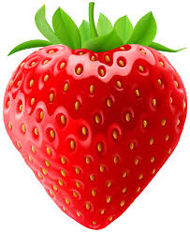
La fresa
The strawberry

Slide 34
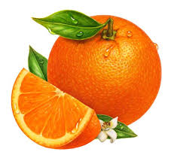
La naranja
The orange
This is the fruit, not the color (anaranjado)

Slide 35
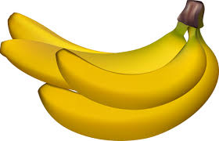
El plátano (la banana)
The banana
The name of this fruit can vary based on country and type of fruit (banana vs. plantain)

Slide 36
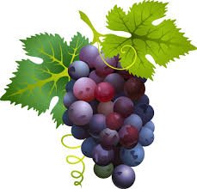
Las uvas
The grapes

Slide 37
Las verduras
The vegetables

Slide 38
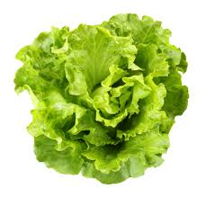
La lechuga
The lettuce

Slide 39
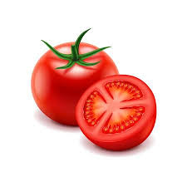
El tomate
The tomato

Slide 40
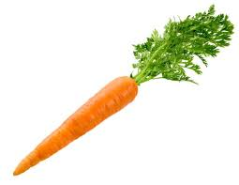
La zanahoria
The carrot

Slide 41
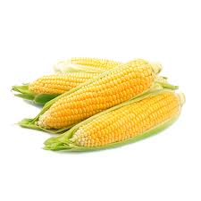
El maíz
The corn

Slide 42
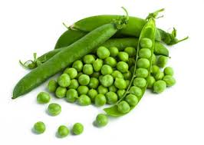
Los guisantes
The peas

Slide 43
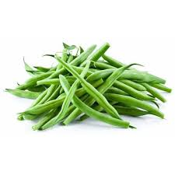
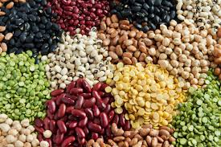
La habichuelas (los frijoles)
The beans
There are many different terms that refer to beans, varying by country and type of bean
Habichuelas refers to the long, green pod (containing small beans) and los frijoles often refers to a single bean

Slide 44
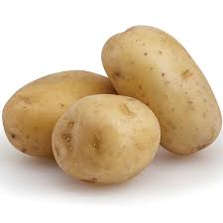
Las papas (las patatas)
The potatoes
This term can vary based on country

Slide 45
Los postres
The desserts

Slide 46
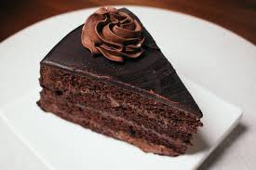
El pastel
The cake (the pastry)
“pastel” is a broad term that can refer to other types of pastry, including pie

Slide 47
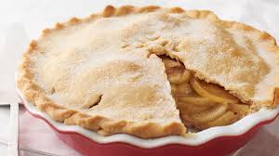
La tarta
The pie

Slide 48
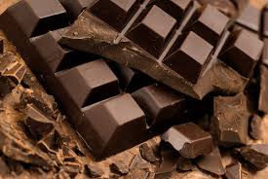
El chocolate
The chocolate

Slide 49
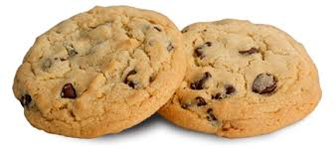
Las galletas
The cookies

Slide 50
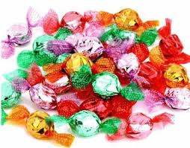
El dulce
The candy
Can also be used in the plural (los dulces) to refer to candies and sweets

Slide 51
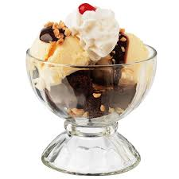
El helado
The ice cream

