Slide 1
How to Make Quiz Corrections
Spanish I

Slide 2
Reminders…
If you earned 10/10, you do not have to do anything with the Quiz Correction Assignment
If you have less than 10/10, quiz corrections are optional
I will not provide class time
I will not accept late submissions, so plan in advance in case you have technical difficulties

Slide 3
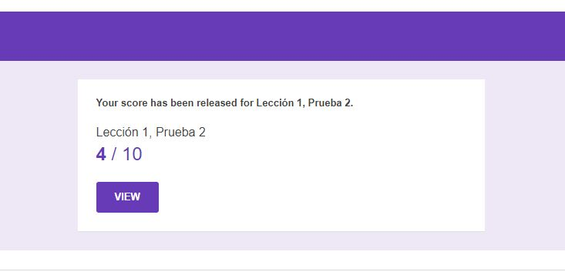
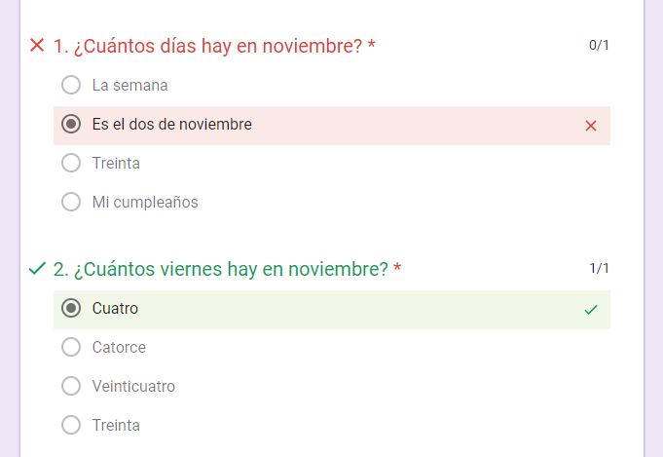
Accessing Your Quiz Results
If you took your quiz online, your results were sent to your school email
In the email, click on “View”
Anything highlighted in red is incorrect
If you cannot open your results in your email, send me an email requesting a printout of your results
I will only print results if you cannot see them electronically
You must prepare to give me advance notice

Slide 4
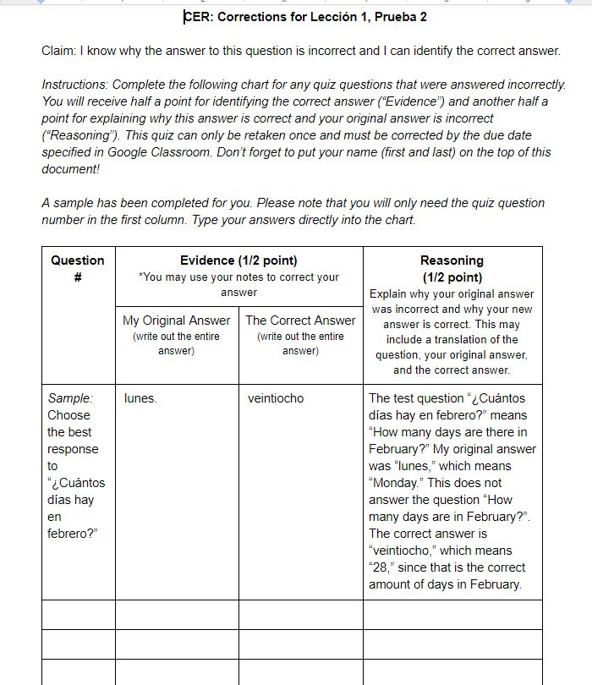
Making Corrections
Go to Google Classroom
Click on the link for the attached Google Doc labeled “CER: Corrections for Lección ___, Prueba ___”
Choose the correct assignment for the current quiz
Complete the chart following the directions and the sample provided within the chart
Click on “Turn In” when you are done
Do not “Share” it with me

