Slide 1
Apuntes: Querer, Poder y Con (Invitaciones)
Lección 3: los pasatiempos

Slide 2
Yo puedo…
I can…
Use the verb querer to talk about wants
Use the verb poder to talk about abilities
It will be helpful to have Vocab 3A for this lesson
Success Criteria:
Ask and answer questions about wants and abilities regarding pastimes

Slide 3
Asking About Wants (Querer)
You can ask people about what they want to do by using these questions and responses:
¿Qué quieres hacer?
Quiero ______ (verb infinitive).
¿Quieres ______ (verb infinitive)?
Sí, quiero ______.
No, no quiero ______.
What do you want to do?
I want to…
Do you want to…?
Yes, I want to…
No, I don’t want to…

Slide 4
Practicar
Examples:
Quiero nadar en la piscina.
¿Quieres patinar en línea?
¡No quiero cantar!
I want to swim in the pool.
Do you want to inline skate?
I don’t want to sing!

Slide 5
¿Qué quieres hacer?
Practicar

Slide 6
Asking About Abilities (Poder)
You can ask about what somebody is able to (“can”) do well or if he/she can do something by using these questions and responses:
¿Qué puedes hacer bien?
Puedo ______ (verb infinitive) bien.
¿Puedes ______ (verb infinitive)?
Sí, puedo _____.
No, no puedo _____.
What can you do well?
I can ____ well.
Can you ___?
Yes, I can ____.
No, I can’t ____.

Slide 7
Practicar
Examples:
Puedo dibujar bien.
¿Puedes andar en patineta?
No puedo esquiar.
I can draw well.
Can you skateboard?
I can’t ski.

Slide 8
¿Qué puedes hacer bien?
Practicar

Slide 9
¿Quieres o puedes?
Object: Ask and answer questions about what you want to and can do.
How:
Meet with a classmate that has a different colored card than you have.
Take turns asking and answering questions in Spanish.
Trade cards and find a new partner. Repeat at least 6 times (three of each color).
Bring your card to the teacher when finished, answer the question on your card, and pick up the homework.
¿Quieres ______?
Sí, quiero _______.
No, no quiero ______.
¿Puedes ______ bien?
Sí, puedo ______ bien.
No, no puedo ______ bien.

Slide 10
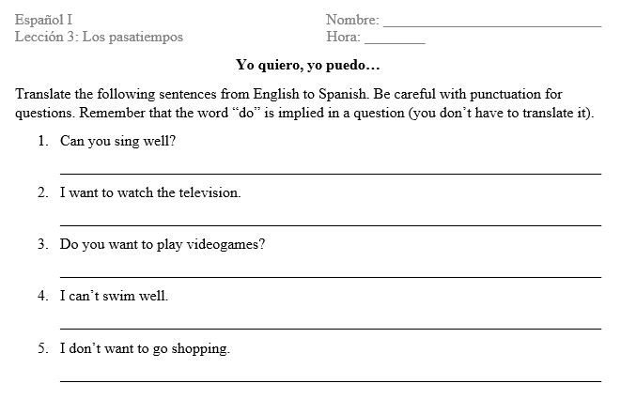
Tarea

Slide 11
Apuntes: Querer, Poder y Con (Invitaciones)
Lección 3: los pasatiempos

Slide 12
Yo puedo…
I can…
Extend and reply to invitations and use the preposition con to tell with whom an activity is done
Respond positively or negatively to requests and invitations
Success Criteria:
Write and present an invitation including…
a question using querer or poder
the infinitive of a verb (activity) and a con expression
the date of the event
time of the event
and place for the event
see grading rubric

Slide 13
The preposition “Con”
with
Con = ______________
Add the preposition con to the question when asking people if they can or want to do something with someone else.
In Spanish, there are special ways to use con with names or pronouns (i.e. yo, tú, él, ella, usted, etc.). Complete the chart with ways to say “con _______”.
conmigo
con nosotros/as
contigo
con vosotros/as
con él/ella, usted (or a name)
con ellos/ellas, ustedes (or names)

Slide 14
Translate
¿Puedo jugar videojuegos contigo?
¿Quieres ver películas conmigo?
Can I play videogames with you?
Do you want to watch movies with me?

Slide 15
Responding to questions/requests
Responding positively (¡sí!)
Sí, puedo…
Sí, quiero…
Responding negatively (¡no!)
Lo siento, pero no puedo… porque…
tengo que (+ infinitive of a verb)
necesito (+ infinitive of a verb)
estoy…
enfermo/a
ocupado/a
cansado/a
Yes, I can…
Yes, I want…
I’m sorry, but I can’t…because…
I have to…
I need to…
I am…
sick
busy
tired

Slide 16
Project: Una invitación
Task: Design an invitation for an activity with you! Include the following information:
Element | Description
A) The invitation for an activity | This should be a question, using either querer or poder conjugated in the tú form and followed by the infinitive of a verb (the activity). Include a con expression to identify that the activity is being done “with me.” Use proper punctuation for a question.
B) La fecha (the date of the activity) | Write out the date in Spanish. The format should be “el + number + de + month.” Write out the number (no digits). See Unit 1.
C) La hora (the time of the activity) | Write out the time of the event. Remember to say “at” and then the time. Write out the numbers (no digits) and include a.m. or p.m. (see Unit 1 for a review of time).
D) El lugar (the place of the activity) | Include the word “in” before the place. Use a general place from your notes on Estar. Do not use a specific name of a place (i.e. Howell).
E) An illustration of the activity | An illustration that matches the activity. Color your illustration.

Slide 17
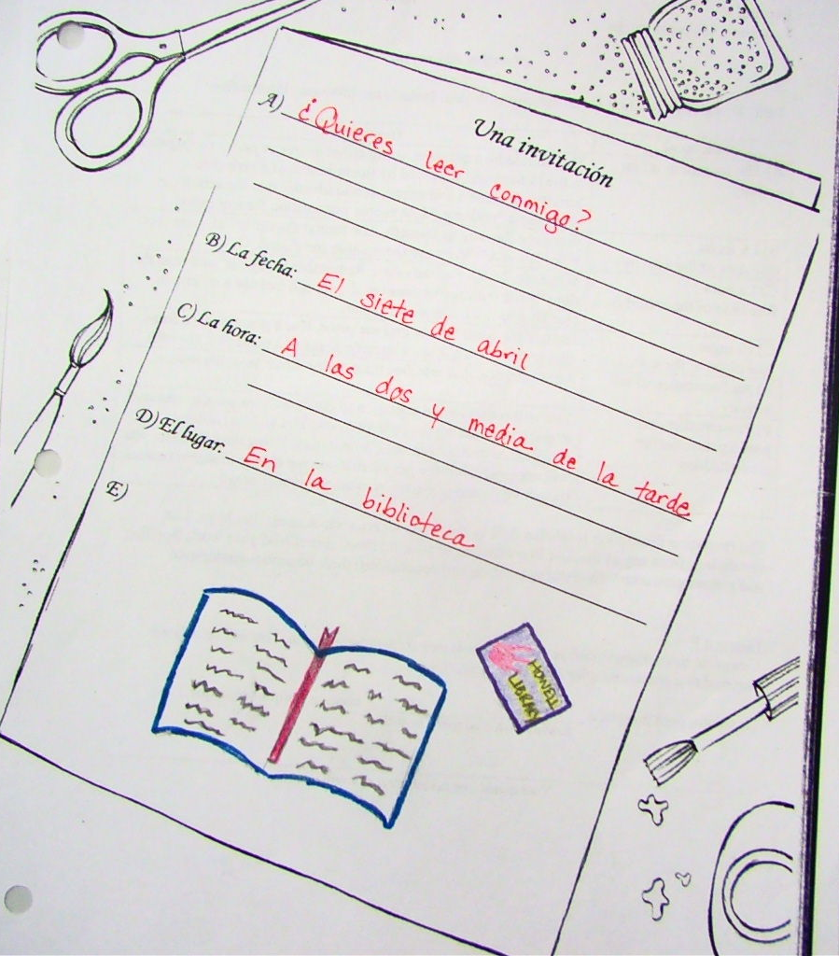
A) The invitation for an activity | This should be a question, using either querer or poder conjugated in the tú form and followed by the infinitive of a verb (the activity). Include a con expression to identify that the activity is being done “with me.” Use proper punctuation for a question.
D) El lugar (the place of the activity) | Include the word “in” before the place. Use a general place from chapters 2-4. Do not use a specific name of a place (i.e. Howell).
B) La fecha (the date of the activity) | Write out the date in Spanish. The format should be “el + number + de + month.” Write out the number (no digits). See Unit 1 for date format.
C) La hora (the time of the activity) | Write out the time of the event. Remember to say “at” and then the time. Write out the numbers (no digits) and include a.m. or p.m. (see Unit 1 for a review of time).
E) An illustration of the activity | An illustration that matches the activity. Color your illustration.

Slide 18
Project: Una invitación
Presentation (Element F)
You will present your invitation to the class. You are also required to participate during the presentations. You will be randomly called on to decline someone’s invitation. Using only Spanish, you will apologize, tell the person that you are unable to attend (restate the activity), and provide a reason. See model below.
Complete this sentence with your reply to another student’s invitation. You will be asked to respond to a classmate after his/her presentation.
Lo siento, pero no puedo ___________ contigo porque…
_______________.
Activity from classmate’s invitation
Your excuse- use the infinitive of a verb

Slide 19
Project: Una invitación
Rubric:
Score _______ X 2 + 5 point Presentation + 5 point Reply (element F) = ________points/20 pts
Score | Description
5 | All required elements are present; question is phrased as complete sentence with proper punctuation; all verbs are conjugated to match the subject; numbers written out; free of grammatical or spelling errors
4.5 | All required elements are present; question is phrased as a complete sentence; verbs are conjugated to match the subject; numbers written out as words; 1-3 minor grammatical or spelling errors
4 | At least 4 out of 5 elements present; question is phrased as a complete sentence; verbs are conjugated; numbers written out as words; 4-5 minor grammatical or spelling errors
3.5 | At least 3 out of 5 elements present; verbs may be conjugated correctly, incorrectly, or left in the infinitive; numbers written out as words or appear as digits; some sentences are incomplete; 6-7 grammatical or spelling errors
3 | At least 3 out of 5 elements present; verbs conjugated correctly, incorrectly, left in the infinitive, or missing completely; numbers written out as words or appear as digits; incomplete sentences; 8-9 grammatical or spelling errors
2 | At least 2 out of 5 elements present; 10 or more grammatical or spelling errors or includes some English
1 | Attempt made, but does not make sense or cannot be read, or is a copy of teacher’s example
0 | No attempt made or written in English

