Slide 2
Apuntes: El horario
Lección 2: En la clase

Slide 3
Yo puedo…
I can…
Ask/tell at what time an event takes place
Success Criteria
Read a class schedule and tell at which time each class meets
Tell when a class begins and ends

Slide 4
La hora- Repaso
¿Qué hora es?
8:15
1:05
11:30
6:50
What time is it?
Son las ocho y cuarto
Es la una y cinco
Son las once y media
Son las siete menos diez

Slide 5
Asking and Telling at What Time an Event Takes Place
To ask at what time an event is going to take place, use this phrase:
¿A qué hora es…?
Translate this example:
¿A qué hora es la clase de español?
At what time is…?
At what time is the Spanish class?

Slide 6
Asking and Telling at What Time an Event Takes Place
To tell at what time an event takes place, use this formula:
Es a la(s) + time
When you use this expression, “es” means “it (the event) is...”
Use “es a la” for 1 o’clock times (one is singular) and “es a las” for times 2-12 o’clock (plural).
The word “son” will not be used when telling at what time an event takes place between 2:00-12:00 because you are not telling the current time, you are telling at what time.
It is at… (time)

Slide 7
Asking and Telling at What Time an Event Takes Place
Translate these examples:
La clase de español es a las ocho de la mañana.
La clase de música es a la una y media de la tarde.
The science class is at 9:45 a.m.
The Spanish class is at 8:00 a.m.
The music class is at 1:30 p.m.
La clase de ciencias es a las diez menos cuarto de la mañana.

Slide 8
Telling When an Event Starts and Ends
To say that an event begins (starts) use the word ___________.
Translate:
La primera hora empieza a las ocho menos veinticuatro de la mañana.
To say when an event ends (finishes), use the word ____________.
Translate:
La séptima hora termina a las dos y dieciséis de la tarde.
empieza
The first hour begins at 7:36 a.m.
termina
The seventh hour ends at 2:16 p.m.

Slide 9
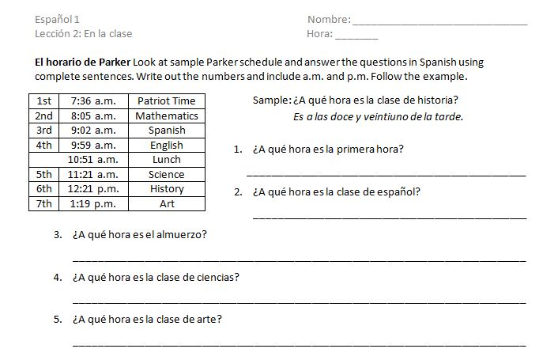
La Tarea

Slide 10
Apuntes: El horario
Lección 2: En la clase

Slide 11
Yo puedo…
I can…
Ask/tell at what time an event takes place
Tell on which day(s) an event takes place
Success Criteria
Read a class schedule and tell at which time or day each class meets

Slide 12
Telling on Which Day(s) an Event Takes Place
To say “on” a certain day in Spanish, we say “el” before the day.
Example: On Tuesday = _____________
Translate:
Hay tarea el miércoles.
El examen es el jueves.
El martes
There is homework on Wednesday.
The test is on Thursday.

Slide 13
Telling on Which Day(s) an Event Takes Place
To say “on” certain days (plural, as in you do something every Friday), we say “los” before the day.
Except for sábados y domingos, the singular and plural forms for days of the week are the same.
Example: On Fridays = _______________
Translate:
¿Cuándo es la clase de arte? La clase de arte es los lunes.
Los viernes
When is art class? The art class is on Mondays.

Slide 14
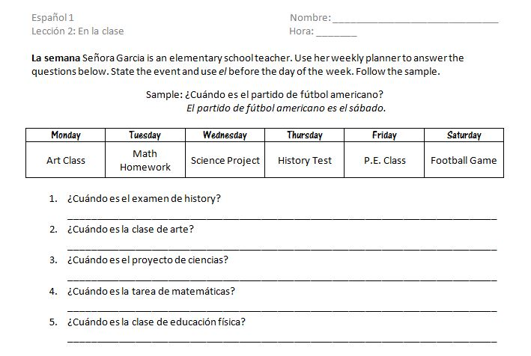
Tarea

