Slide 1
Apuntes: Los Adjetivos
Lección 5: La familia

Slide 2
Yo puedo…
I can…
Use ser and adjectives to describe personality and physical traits
Make adjectives agree with nouns in gender and number
Success Criteria:
Form the masculine/feminine, singular/plural forms of adjectives
Write complete sentences with a subject, conjugated form of ser (to be), and an adjective that matches the subject in gender and number

Slide 3
What is an Adjective?
An adjective is a word that ____________ a person, place or thing (nouns).
Adjectives that describe personality and physical traits are used with the verb _________.
describes
ser

Slide 4
Adjective-Noun Agreement
In Spanish, adjectives agree in both ______________ and _______________ with the noun that they describe.
Masculine adjectives end in _______ and feminine adjectives end in _______. To make these adjectives plural, add an ________.
gender
number
o
a
s

Slide 5
Adjective-Noun Agreement
Complete the chart:
Alta
Altos
Altas
Bueno
Buenos
Buenas
Pequeño
Pequeña
Pequeñas
Simpático
Simpática
Simpáticos

Slide 6
Adjective-Noun Agreement
e
Adjectives that end in ________ or a consonant have the same masculine and feminine forms. These adjectives will still match in number with the noun that they describe.
Examples: inteligente, inteligentes
difícil, difíciles
Adjectives that end in _________ are changed into the feminine form by adding an _______.
Example: trabajador, ___________, trabajadores, ___________
-or
a
trabajadora
trabajadoras

Slide 7
Adjective-Noun Agreement
If you are describing more than one noun, and at least one of those nouns is masculine, use the __________________ ________________ form of the adjective.
Example: Juan y Lola son altos.
masculine
plural
Juan and Lola are tall.

Slide 8
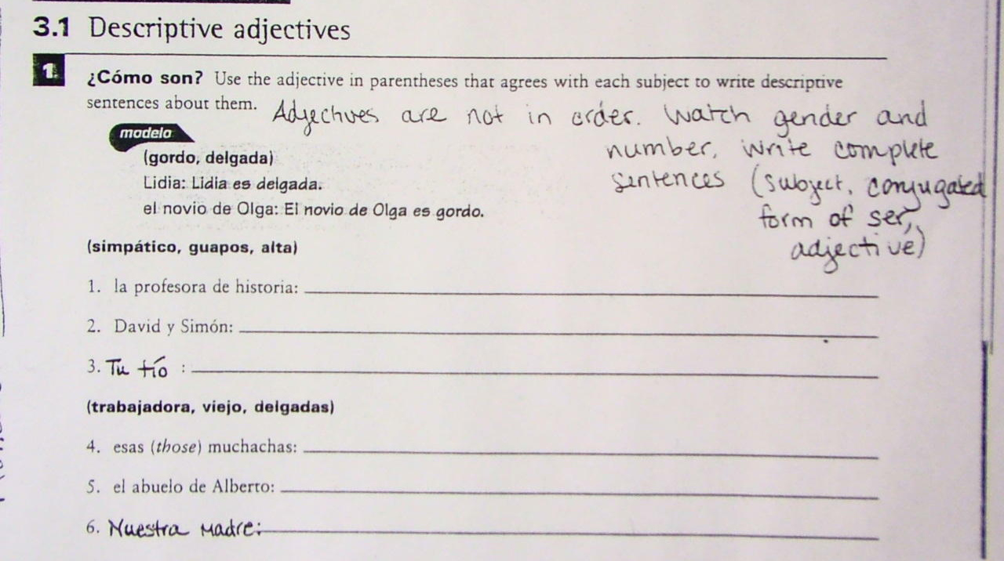
Tarea

Slide 9
Apuntes: Los Adjetivos
Adjective Placement

Slide 10
Yo puedo…
I can…
Recognize the proper placement of adjectives in relation to the nouns that they describe
Success Criteria:
Create labels of family members using correct adjective-noun placement

Slide 11
Dos frases/Two sentences
Los estudiantes buenos estudian para los exámenes.
Vs.
The good students study for the tests.
Both sentences mean the same thing. What is different about them?

Slide 12
Adjective Placement
Descriptive adjectives and adjectives of nationality (pg. 89) generally __________ the nouns that they describe.
Examples:
El niño rubio es de España. →
La mujer española habla inglés. →
follow
The blonde boy is from Spain.
The Spanish woman speaks English.

Slide 13
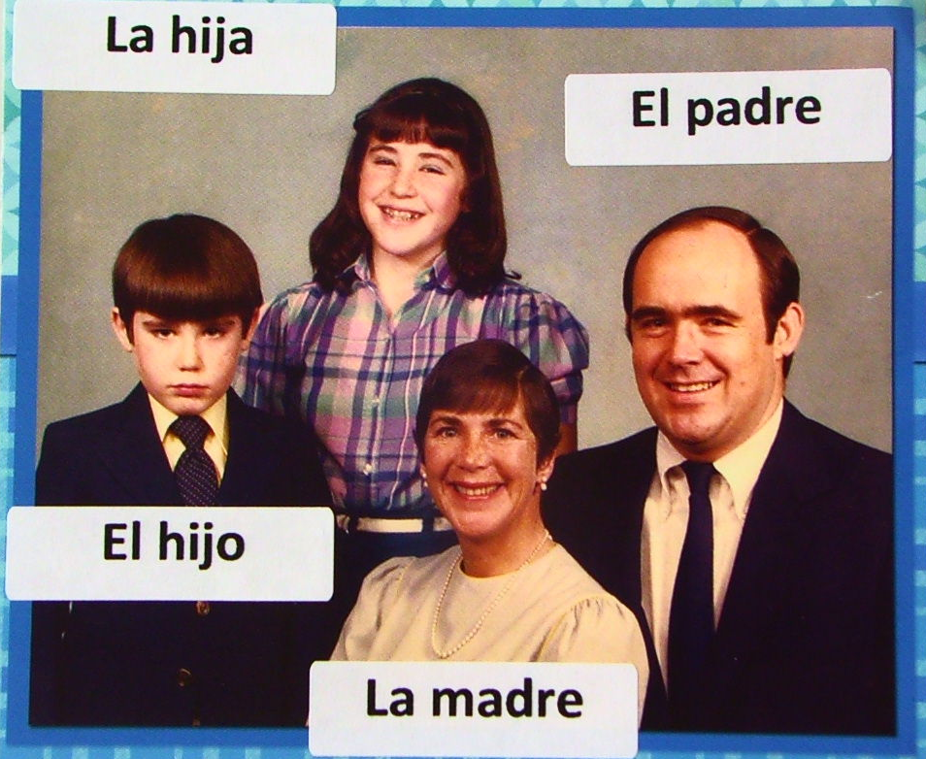
Label the Family
La madre __________
El hijo ____________
La hija ____________
El padre ___________

Slide 14
Adjective Placement
Adjectives of quantity (including numbers) are placed _________________ the noun.
Examples:
Hay muchos estudiantes en la clase. →
Hablo con dos muchachas simpáticas. →
before
There are many students in the class.
I am speaking with two nice girls.

Slide 15
Adjective Placement
Bueno/a and malo/a can be placed before or after the noun. When placed before a masculine singular noun, bueno is shorted to __________ and malo is shortened to _____________.
Examples:
Joaquín es un buen amigo.
Joaquín es un amigo bueno.
Hoy es un mal día.
Hoy es un día malo.
buen
mal
→
Joaquín is a good friend.
→
Today is a bad day.

Slide 16
Adjective Placement
When grande appears before a singular noun, it is shortened to _____________.
The meaning of the word also changes: gran = ___________ and grande = ___________.
Examples:
Ella es una gran profesora. →
Es una familia grande. →
gran
great
large, big
She is a great teacher.
It is a large family.

Slide 17
Una familia interesante
Names on BACK (this is an art contest, not a popularity contest!)
Fill the frames with six different fictional family members
Next to each frame, write a description (“label”) of the family member in Spanish (i.e. la madre delgada)
Descriptions must match the pictures
Pictures must be school appropriate
Be careful about adjective-noun agreement (gender and number) and adjective placement (after the noun)
I am NOT looking for complete sentences – just labels!
Use vocabulary from Vocab 3A/B/C (do not go online for vocab!)
Color the pictures
Grading
10 points total
See grading rubric
Illustrations are due on TBA

